Slide 1
Network blocking can be based on:
What you say
Whom you talk to
In order to resist blocking, you need to defeat both.

Slide 2
Idea: domain fronting
Using features of the HTTPS protocol, we construct messages that
On the outside, are addressed to a common unblocked domain, like Google or Amazon.
On the inside, are actually addressed to our proxy server.
The blocker sees only the outside, and so cannot distinguish our traffic from other web traffic.

Slide 3
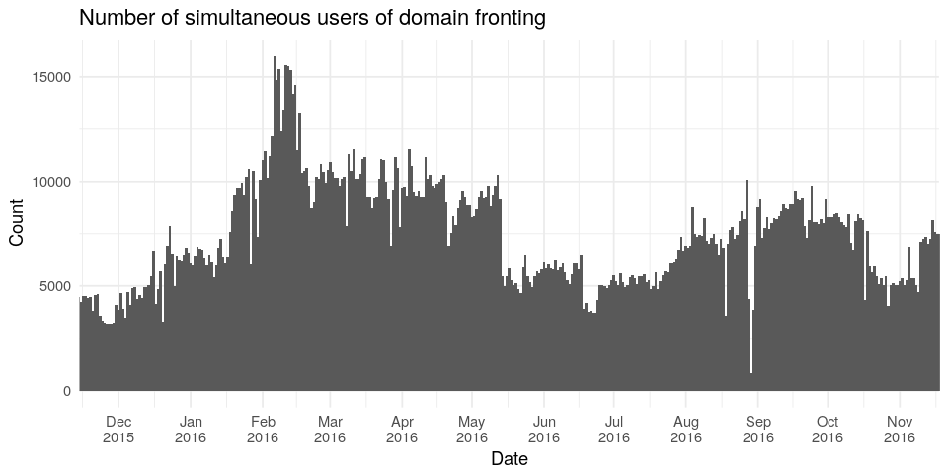

Slide 4
